Slide 1
Dynamics 365 Business Central
Incremental Group

Slide 2
Dynamics 365 Business Central including Manufacturing
Implement D365 BC with Manufacturing
£35,000 + licenses (premium license required)
Timescale – 3 weeks delivery

Slide 3
D365 BUSINESS CENTRAL Project Timeline
1-3 days
4-12 days
12-15 days
KICK-OFF
Set out and agree timelines
Set out and agree project processes and outcomes
Carry out interviews with key staff
Introduce and walk through data templates
Discuss how Business Central (BC) postings work to ensure that the principles are understood before completing of the data templates
TENANT SET-UP
Set up BC Tenant
Create user profiles in Dynamics BC (This is all users who will use BC by full name, job role and the type of license required - full/limited.
DATA TEMPLATES COMPLETED
Extraction of data from current system
Fields matched for BC
Review and clean of data
BC Modules SET-UP
Import of data from templates
Set up core capability
Data validation
Set up for testing
REVIEW & TRAINING
Joint review and test of system and data
Super user training
UAT
USER FAMILIARISATION
Push example quotes, orders, invoices etc through BC
Testing plan used to ensure all users know processes related to their roles
Online videos and training guides made available
GO LIVE
Support on site & remotely
Is more training required?
Anything else!
FEEDBACK & COMMUNICATION

Slide 4
Core capability delivered
FINANCE
Master Planning
General
Ledger
Accounts
Payable
Accounts
Receivable
Multi Currency
Time and Expense Management
Financial Reporting and Analytics
Credit and Collections
Managing Bank Accounts
Intelligent insights
Bank Reconciliation
Project Costing Accounting
Accounting for costs
Fixed Asset
Management
Consolidations
Intercompany transactions
Regulatory Compliance
Purchase and Sales orders
Cashflow analysis
Working with dimension
Managing Inventory costs
Allocate costs and income
Tax
Import payroll transactions
Defer revenue and expenses
Work with Excel
Stock Management and basic warehousing
Productive experiences
Demand Forecasting
Transfer inventory between locations
Inventory Management
Transportation Management
Vendor Collaboration
Finance and Stock Integration
Warehouse Management
Live inventory
visibility
Power of cloud scale
Inbound
Consignment
Bills of
Materials
Purchase Order Management
Item Catalogue
Quality Management
Sales and CRM
Assisted Selling With Intelligent Recommendations
Sales quote
Manage Invoice Sales
Rules-based Distributed Order Management
Product Category, Catalog And Assortment Management
Business anytime, anywhere
Create Recurring sales lines
Make drop shipments
Product Price And Promotions Management
Sales returns or cancellation management
Create Sales orders
Create
customer cards
Manufacturing
Production orders
Capacity and material planning
Job scheduling and sequencing
Resource Management
Shop floor management
Production configuration
Work order management
Quality management
Forecast scheduling
Lean manufacturing
Notes:
Dynamics 365 for Finance and Operations key differentiations:
Intelligent Insights: Turning data into actionable intelligence
Productive Experiences: Engaged and empowered employees on the strength of productivity, user experience, business process, and mobility
Power of cloud: Customer in control, business agility, scale with your business, familiar developer tools
Business Anytime, Anywhere: Mobilize your work, simply powerful, cloud-powered compliance, Intelligent Cloud

Slide 5
D365 BUSINESS CENTRAL Scope of requirement
Item | Description | Effort in Days | Total
Implementation of core Finance | Configuration of core finance (general ledger) Configuration of Purchase capability Configuration of account schedules Data migration | 9 days | £8,550
Implementation Stock and Warehouse management | Configuration of inventory management, stock, ordering and pricing Data Migration | 5 days | £4,750
Implementation of Sales and CRM | Configuration of Sales CRM capability, vendor management and sales ledger. Data Migration | 4.5 days | £3,500
Implementation of Manufacturing | Configuration of manufacturing process, job scheduling and production configuration | 5 | £4,750
Training Service | On site training of all license holders | 3 days | £3,000
Project Management | Project management, kick off sessions, project support and project close | 3 days | £2,550
Reporting and Power BI | Develop Power BI Dashboards | 5 days | £4,750
Go live assistance | On site support during go live | 2 days | £1,900
Optimisation hours | 1.5 days additional consultant support, to cover post go live and any small requirement tweaks | 1.5 days | £1,350
Total |  | 36.5 days | £35,000

Slide 6
D365 BUSINESS CENTRAL Additional Capability available
Service Management
Advanced Finance
Advanced Warehouse Management
Support Contracts available
Quotes Available on Request

Slide 7
D365 BUSINESS CENTRAL Licenses
Essentials
£52.79
Premium
£75.40
(manufacturing + service management)
Team Member £6
All licenses are per user per month

Slide 8
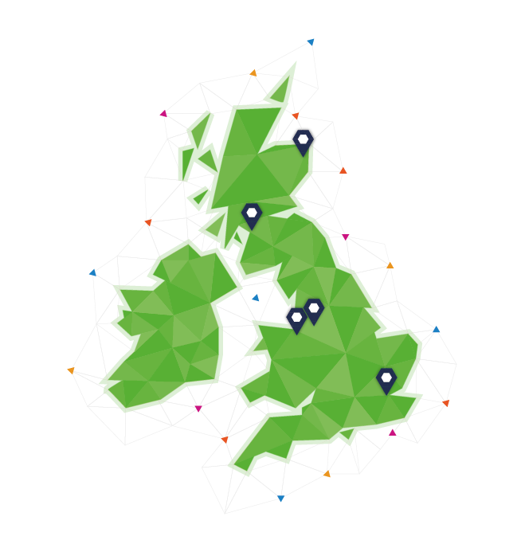
Incremental’s BC team
Incremental has a team of 65 Microsoft Certified Dynamics consultants across 5 UK offices, supported by a team of developers and cloud specialists

Slide 9
Why choose Incremental as BC partner?
As one of the few UK partners with expertise in both Dynamics 365 Finance and Operations and Business Central, Incremental helps organisations understand what D365 solution best suits their needs. We have a large team of experienced Microsoft ERP consultants many with experience in operations and accountancy.
Full spectrum of Microsoft services helps organisations leverage the benefits of the full package of cloud based Microsoft solutions
Cloud engineers – complex infrastructure, Citrix and Azure specialists
Data engineers and scientists - use PowerBI and leverage Azure to build AI and machine learning solutions
Application developers – build portals, PowerApps and custom applications
Office 365 consultants – advise on and implement the tools
Incremental is an early adopter of Business Central developing a practise of specialist D365 Consultants
Microsoft Gold Partner
Enterprise Resource Planning
Customer Relationship Management
Data Center
Application Development
ISV

